Slide 1
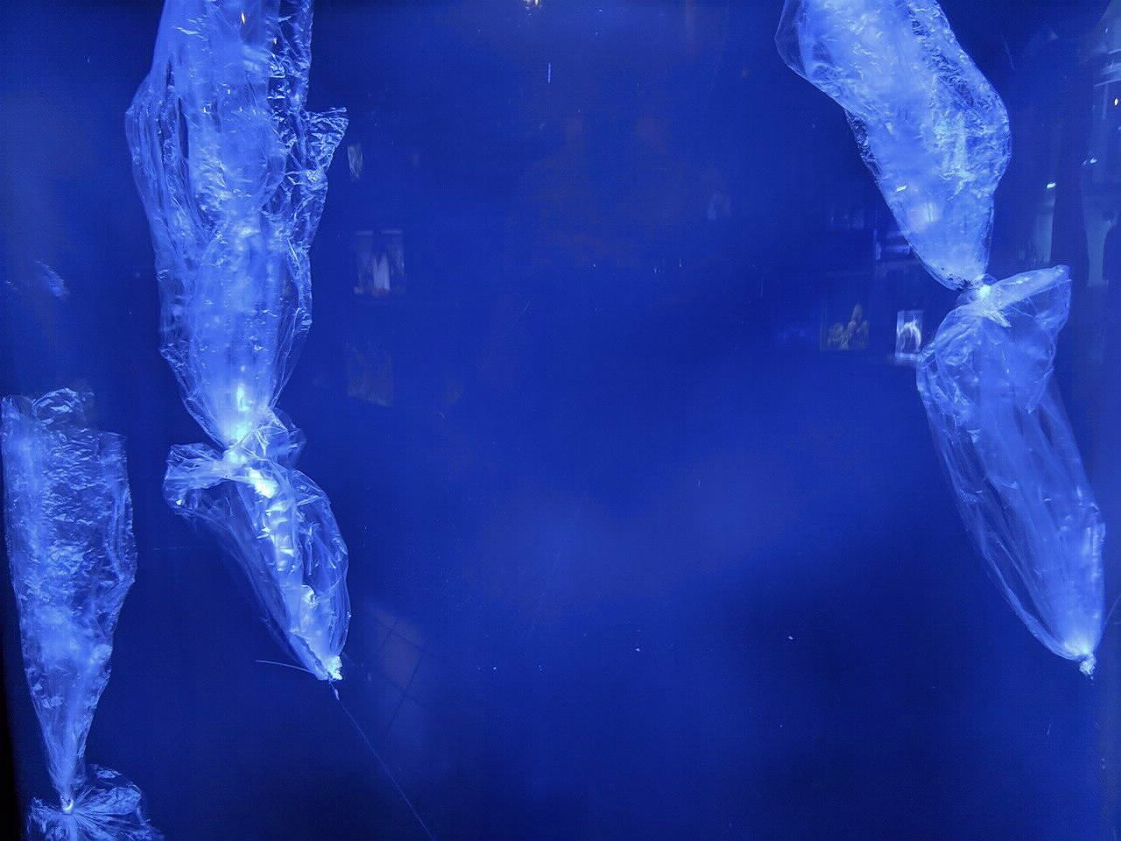
Syllabus:
Plastics in the Ocean
Welcome to the Unit on
Plastics in the Ocean!
This will be a Project-Based Learning Unit
Fact: More than 1 million seabirds and 100,000 marine animals die from plastic pollution every year.
Driving Question:
How can we help reduce plastics in our oceans?
Description
Through research, collaborative thinking, and group work, each team will come up with a solution to help reduce plastics in our oceans. The team will then present their solution in a creative way. Throughout the unit, teams will assess their own progress, and will work with the teacher to stay on task.

